Slide 1
Diffusion-based Latent Image Generation with Label Conditioning: A Score-Based Approach
Tawsif Mahmud 1912411042
Jiaul Haque Saboj 1912065042
Sadia Sifati Shammee 1912304042
Supervisor: Dr. Mohammad Ashrafuzzaman khan

Slide 2
PROJECT OVERVIEW
Objective: The project aims to develop a novel method for generating high-quality images by leveraging diffusion models and label conditioning.
Significance: Image generation plays a crucial role in various fields, including computer vision, graphics, and creative applications. Our approach offers enhanced control over image attributes through label conditioning, enabling the generation of images with specific characteristics.
Key Features:
Incorporation of label conditioning to generate images with desired attributes.
Adoption of a score-based approach for improved image quality and control.

Slide 3
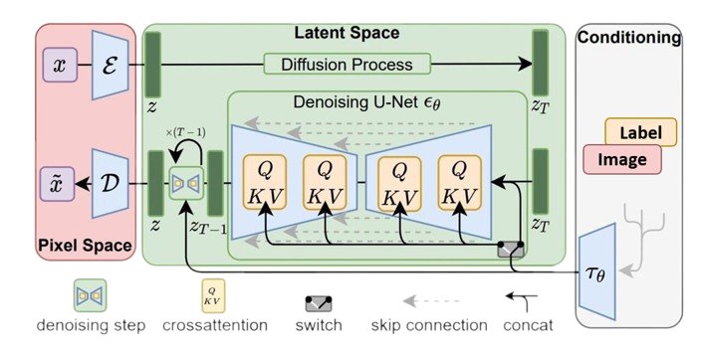
ANALYSIS OF DESIGN PRINCIPAL
The fundamental ideas and concepts that shape the development of the diffusion-based latent image generation with label conditioning system. These principles include the score-based approach, diffusion model, Unet architecture, training on diverse datasets, and computational efficiency. These principles guide the overall design, architecture, and implementation of our system to achieve the desired objectives of generating high-quality, diverse, and controllable images with label conditioning.

Slide 4
USABILITY,MANUFACTURABILITY,SUSTAINABILITY
Usability:
Our research work focuses on enhancing the usability of image generation systems by incorporating label conditioning. This allows users to have fine-grained control over the generated images, enabling various applications such as image synthesis, data augmentation, and content manipulation.
Manufacturability:
While our project is primarily research-oriented, the concepts and techniques developed can be implemented in practical applications. The diffusion model with label conditioning can be integrated into existing image generation systems and frameworks, allowing for scalable and efficient manufacturing of image generation tools.
Sustainability:
Our research work contributes to the sustainability of image generation technologies by improving the quality and diversity of generated images. By leveraging label conditioning, we enable more precise control over image synthesis, reducing the need for additional data collection and annotation efforts.

Slide 5
IMPLEMENTATION
Diffusion Model: Utilizes iterative steps to refine generated images, gradually reducing noise and improving image quality.
Latent Space: Applies latent space techniques to denoise images and enhance their visual fidelity.
Label Conditioning: Incorporates label conditioning using the Unet model, allowing the generation of images based on specific labels or attributes.
Training on Datasets: Trained on MNIST and Fashion MNIST datasets to learn underlying patterns and distributions for generating diverse and realistic images.
Future Work: Plan to train the model with larger and more complex datasets, and explore advanced conditional approaches.

Slide 6
DEVELOPMENT PROCESS
Research: Conducted in-depth research on diffusion models and score-based approaches for latent image generation with label conditioning.
Data Preparation: Preprocessed and prepared the Mnist and Fashion Mnist datasets for training the model.
Model Design: Designed the architecture of the diffusion model combined with a Unet for denoising and label conditioning.
Training and Optimization: Trained the model using the prepared dataset and optimized the model's performance through iterations and fine-tuning.
Evaluation and Validation: Evaluated the generated images using quantitative metrics and performed validation to ensure the model's effectiveness.
Future Enhancements: Identified areas for future improvement, such as scaling up the dataset, exploring advanced conditioning techniques, and refining the model's performance.

Slide 7
ENVIRONMENTAL CONSIDERATION
Energy Efficiency: Our diffusion-based latent image generation model with label conditioning was designed to be computationally efficient, reducing energy consumption during training and inference.
Data Efficiency: By training the model on a smaller dataset, we aimed to minimize the amount of data required, promoting data efficiency and reducing the environmental impact of data collection.
Model Optimization: We continuously explored methods to optimize our model architecture and training process to improve performance while reducing computational requirements, thus promoting sustainability by minimizing resource usage.
Paperless Documentation: We prioritized digital documentation and collaboration tools to minimize paper usage and promote a sustainable work environment.

Slide 8
TOOLS AND TECHNOLOGIES
PyTorch: We utilized the PyTorch framework, a popular deep learning library, for implementing and training our diffusion-based latent image generation model with label conditioning.
Google Colab Pro: To accelerate the training process, we leveraged Colab Pro, which provide high-performance computing capabilities for deep learning tasks.
GitHub: We utilized GitHub for version control, collaboration, and sharing our project code and resources with the community, promoting transparency and facilitating reproducibility.
Data Visualization Tools: For visualizing and analyzing the results, we employed various data visualization libraries in Python, such as Matplotlib and Seaborn, to gain insights into the generated images and model performance.

Slide 9
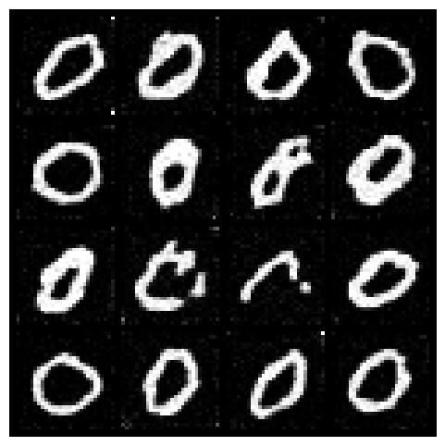
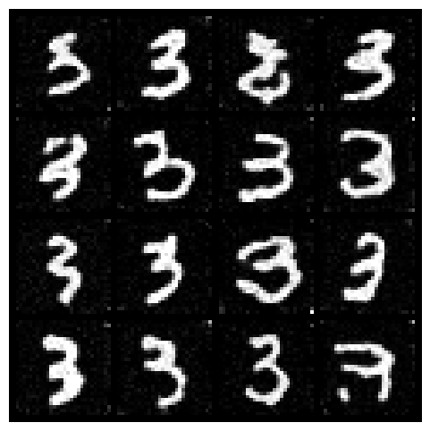
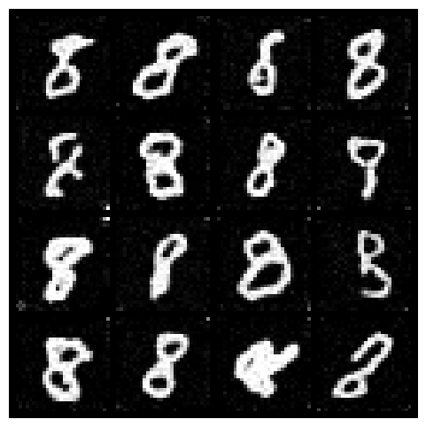
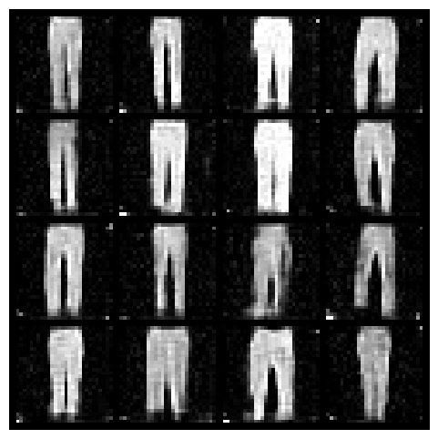
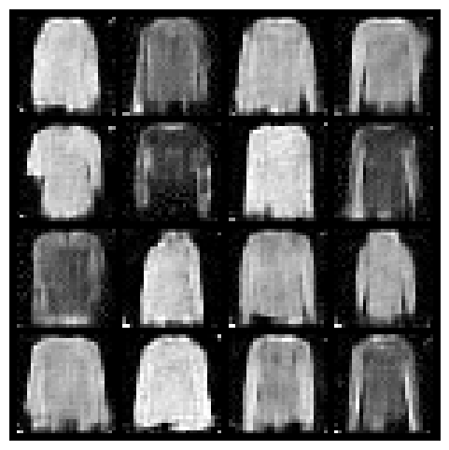
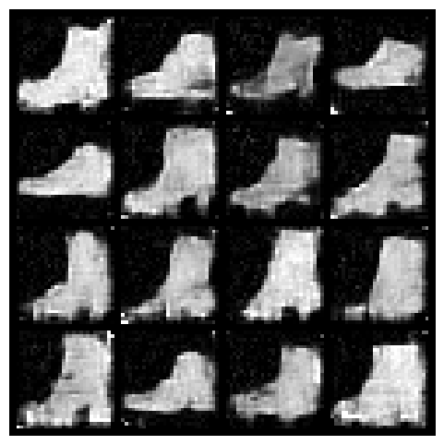
RESULTS
Generated MNIST Image
Generated Fashion MNIST Image

Slide 10
Thank You

